Slide 1
2022 IIOE
Annual Partnership Meeting
January 5, 2023

Slide 2
IIOE-KNC, UNIVERSITY OF NAIROBI
KENYA
Transforming Online Pedagogy for Effective Curriculum Delivery in Higher Education Institutions in Kenya
Justus Inyega - Director, IIOE-KNC

Slide 3
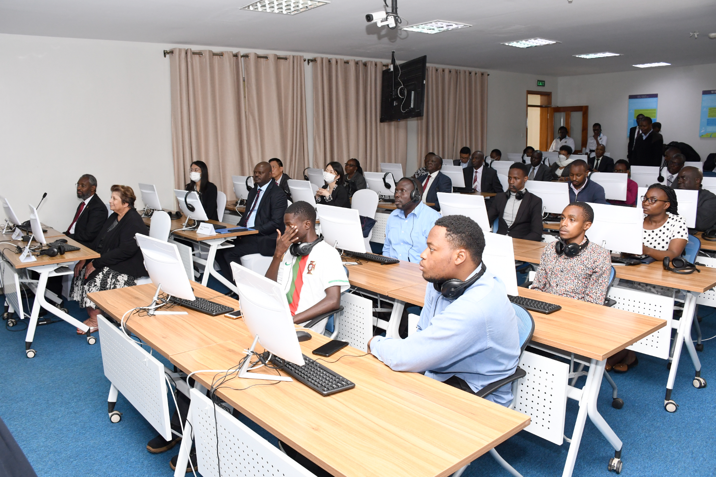
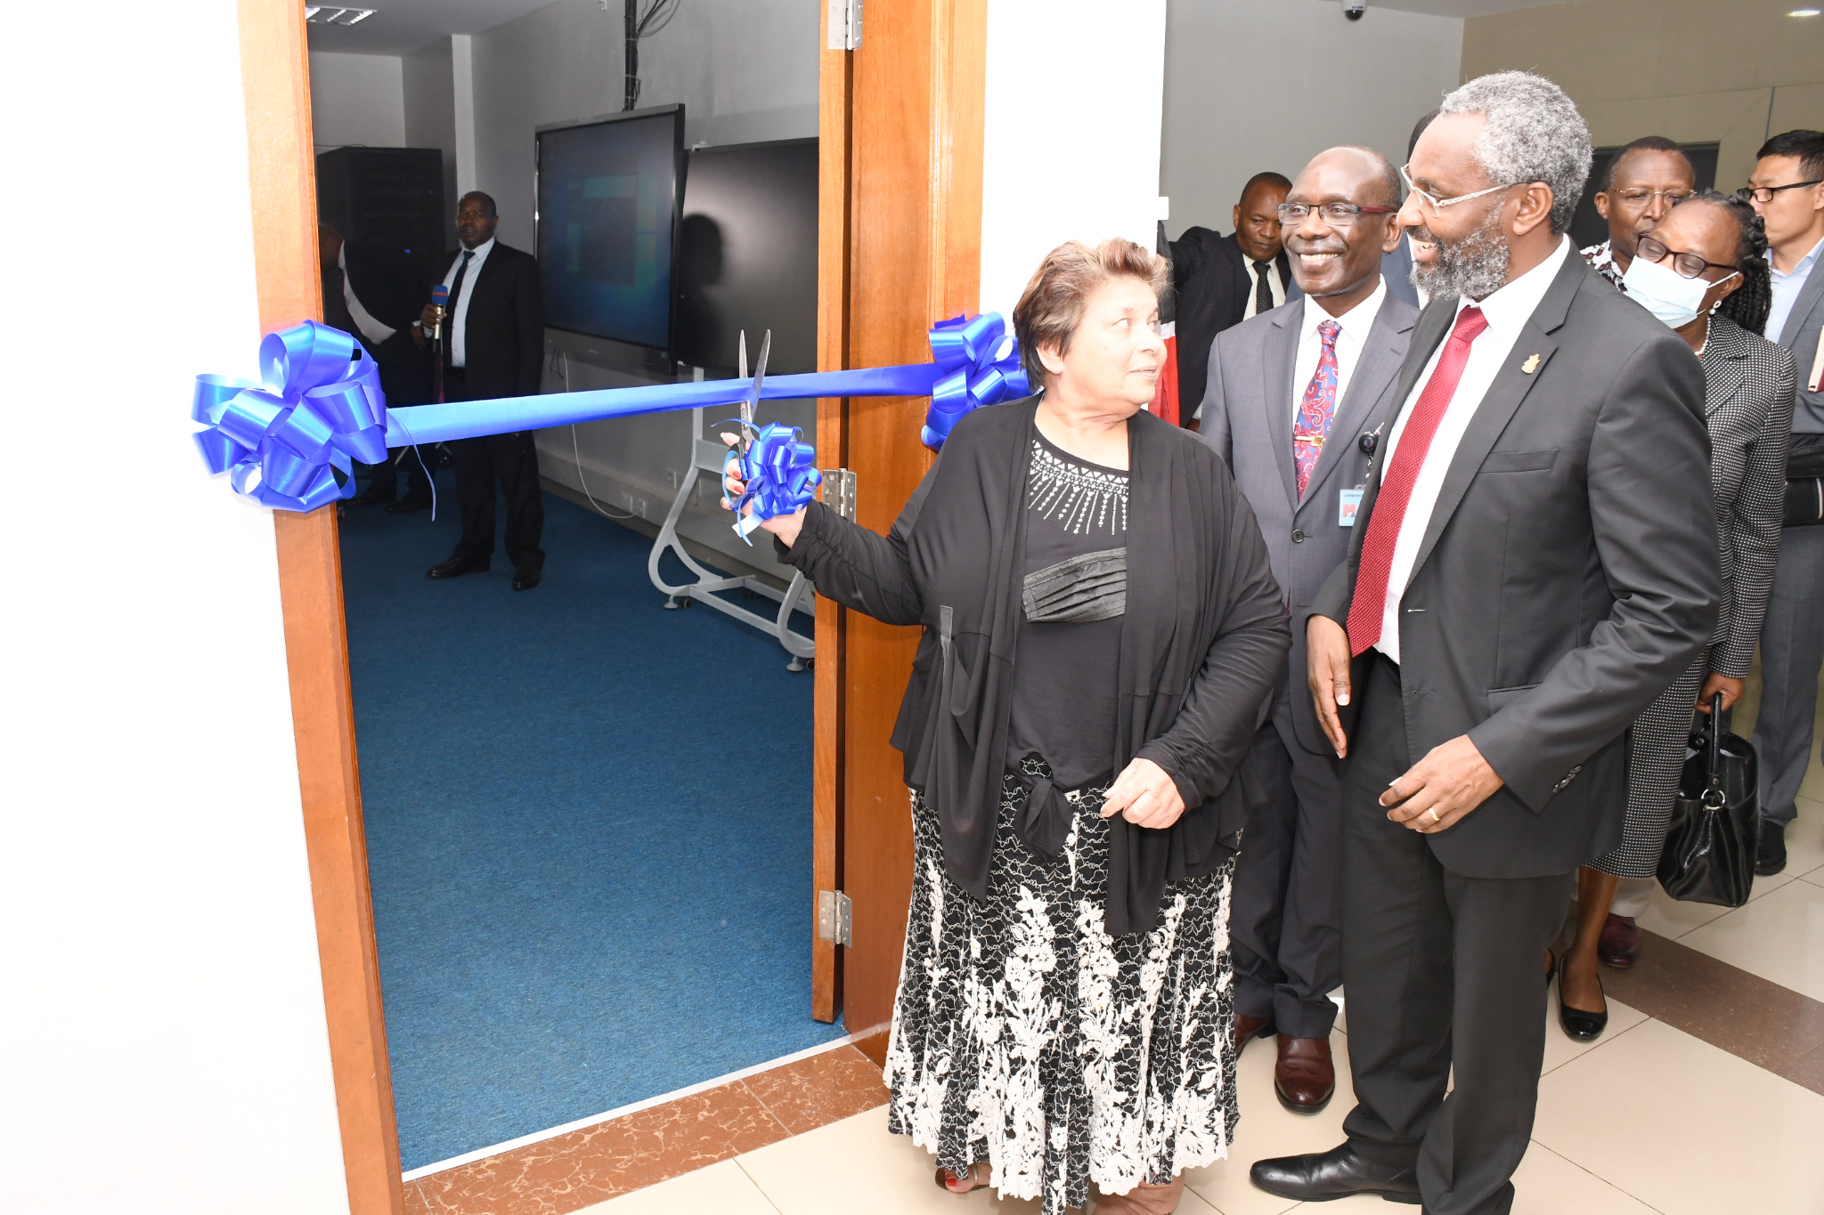
Summary of the status, activities, results and achievement of the project
Smart Class Room Launch

Slide 4
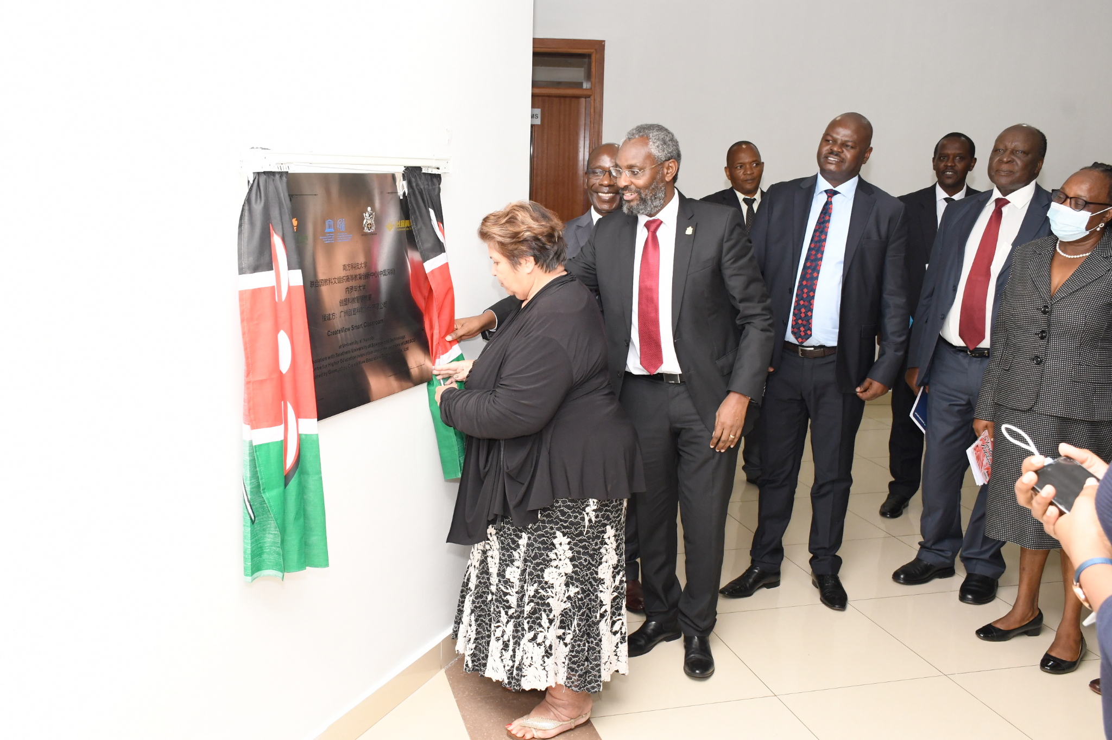
Launch of IIOE-KNC
2. Launch of IIOE-KNC project implementation plan

Slide 5
Digital transformative pedagogy training (DTP)
42%
58%
71%
Female
Male
Completed
and 26 female
36 male
62 participants completed of the 87
Established partnerships with 4 universities in Kenya (Egerton, Umma, Pwani and Maasai Mara)
43 UoN, and
19 from the partner universities

Slide 6
Project deliverables
Best Practice
Courses Design
6 Case studies on best practices for digital teaching and learning were documented
4 Quality online courses designed, 3 completed and 1 in progres
A project report compiled
Rubrics
Upscaling plan
2 Assessment rubrics developed
Upscaling plan of Training of Trainers (ToT) has been developed

Slide 7
Monitoring and evaluation of teaching and learning activities of digital transformative pedagogy course is ongoing
Facilitators’ monitoring and evaluation of project output

Slide 8
FEEDBACK

Slide 9
Virginia Gichuru
Participant - DTP Pwani University
… I found the training an eye opener on how to transform my teaching and make it relevant for the 21st century using digital tools.
I learnt how to do course design, how to effectively facilitate teaching and learning and finally how to carry out innovative assessment. I am looking forward to implementing many of the learnt ideas in the new semester where I will be teaching two units in a Blended mode.This training could not have come at a better time. I would also like to complete the advanced part of the course in order to be more competent. The course was very interactive through the Zoom online sessions with our facilitators. I enjoyed the asynchronous sessions which were varied and engaging. My desire is to transform my courses to fit what we learnt during this DTP Training.
I look forward to more trainings and also to be able to transfer skills to my colleagues.

Slide 10
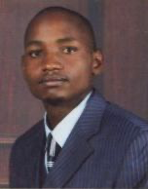
Jared Ongaro
DTP Facilitator, University of Nairobi
… student can learn whether we teach them or we don’t, what we seek is effectiveness. Technology alone won’t be enough to improve teaching and learning to where it needs to be for 21st century skills.
Where it is being used successfully, teachers collectively share a vision of promoting deeper learning in all their students, and have collaboratively redesigned the role of the teacher to that of facilitator who uses technology as a tool in their educational aims. As facilitators, we teachers become learning strategists who constantly plan ways to enable students to master complex content knowledge and develop their critical thinking, problem solving, communication, and collaboration skills.
This is exactly what makes DTP so unique in shaping a community of best practice.

Slide 11
LESSONS LEARNT
Successes
University Management
Digital pedagogy
Digital transformation
Updated ICT infrastructure
Play a pivotal role to pin the DTP training leading to enhanced teaching and learning processes
Its adoption as a viable mode of facilitation enhances learning processes
Creates opportunities to enhance networking and partnership, creating ‘global classrooms’
Enables effective implementation of DTP

Slide 12
LESSONS LEARNT CONT’D
Challenges
The program involved participants from various universities with varying timetable of activities hence some participants could not attend the live interactive sessions fully
Internet connectivity challenges and some participants needed to upgrade their internet to enjoy the training better.

Slide 13
WAY FORWARD
Upscale the project to involve more universities and participants.
Carry out action research on DTP@UoN and partner universities to inform teaching and learning processes.
Advanced skills training to include: Authoring Tools, Learning Design and Learning Analytics for online courses.
Follow up on those trained on DTP for best practices and model case studies

Slide 14
Thank you!

